Slide 1
Lecture 4
Premixed turbulent combustion:
Fundamental notions
4.-1

Slide 2
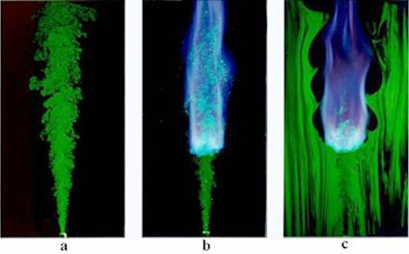
Premixed combustion at the lift-off length of a lifted flame

Slide 3
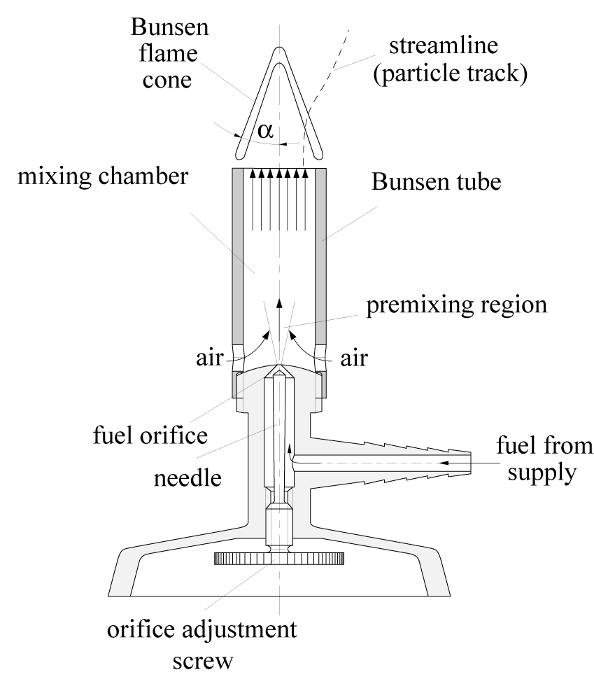
The classical configuration:
the Bunsen burner
classical device to generate a
premixed flame.
Gaseous fuel enters into the mixing
chamber, into which air is entrained.
The velocity of the jet entering into the
mixing chamber may be varied and the
entrainment of the air and the mixing
can be optimized.
4.-2

Slide 4
The mixing chamber must be
long enough to generate a
premixed gas issuing from the
Bunsen tube into the surroundings.
If the velocity of the issuing flow
is larger than the
burning velocity to be
defined below, a Bunsen flame cone
establishes at the top of the tube.
4.-3

Slide 5
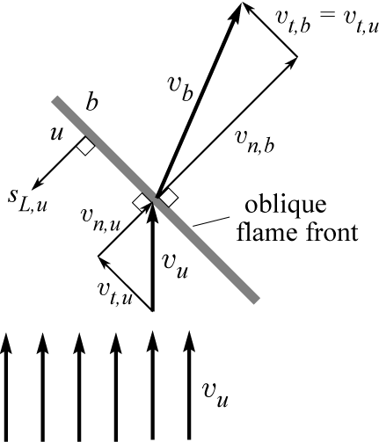
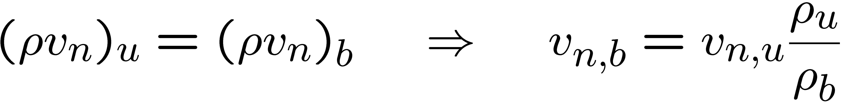

Kinematic balance for a steady oblique
laminar flame:
The oncoming flow velocity v_{u} of the unburnt
mixture (subscript u) is split into a
component v_{t,u} which is tangential to the flame
and into a component v_{n,u} normal to the flame front.
Due to thermal expansion within the flame
front the normal velocity component is increased,
since the mass flow density ρv_{n} through the flame must be the same in the unburnt mixture and in the burnt gas (subscript b).
The tangential velocity v_{t} is not affected by the gas expansion:
4.-4

Slide 6
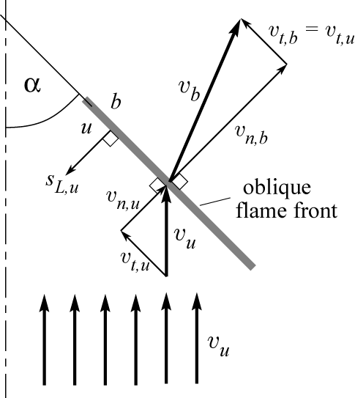
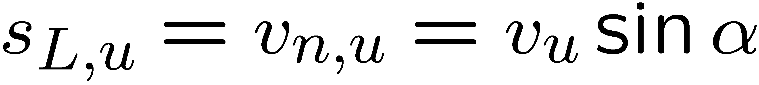
Vector addition of the velocity components in
the burnt gas leads to v_{b} which points into a
direction which is deflected from the flow
direction of the unburnt mixture.
Since the flame front is stationary, the
burning velocity s_{L,u} with respect to the
unburnt mixture must be equal to the flow velocity
of the unburnt mixture normal to the front
where α is the Bunsen flame cone angle.
This allows to experimentally determine the burning velocity by measuring the cone angle α under the condition that the flow velocity v_{u} is uniform across the tube exit.
4.-5

Slide 7
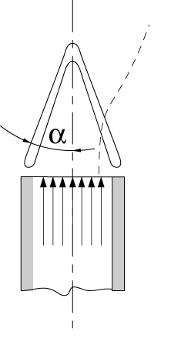
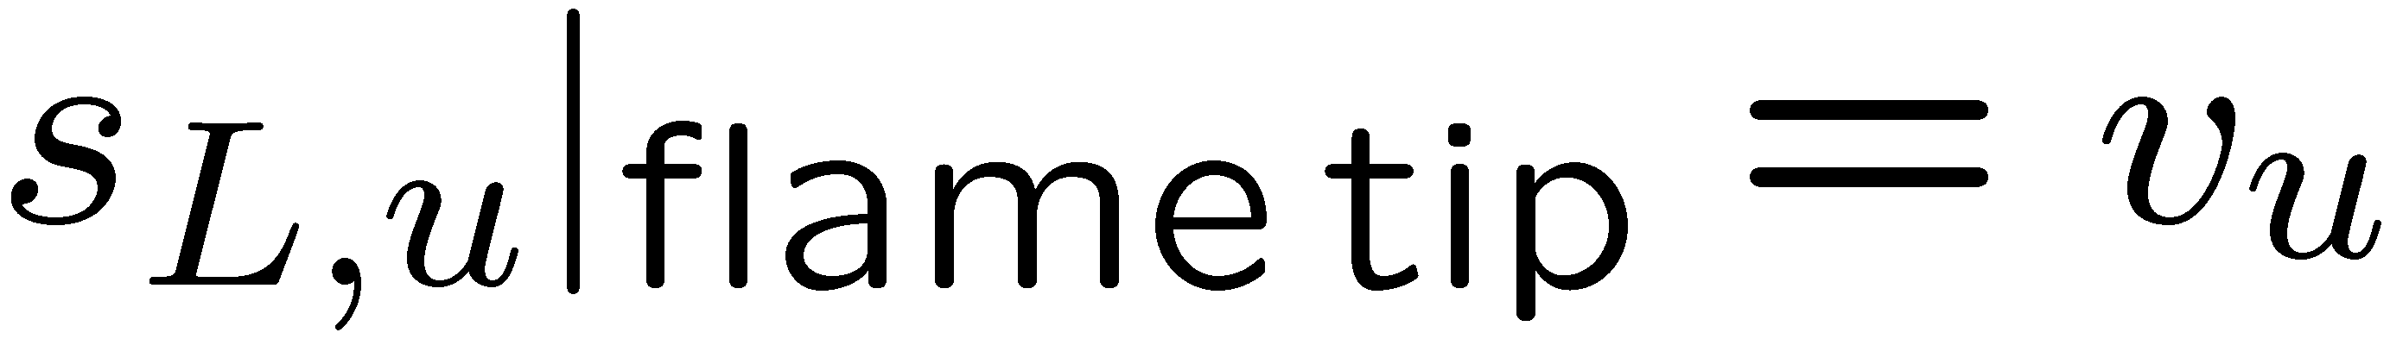
A particular phenomenon occurs at the flame tip.
If the tip is closed, the burning velocity at the tip is
equal to the flow velocity
Therefore the burning velocity at the flame tip is by
a factor 1 / sin α larger than the burning velocity through
the oblique part of the cone.
Explanation: the strong curvature of the flame front at the tip leads to a preheating by the lateral parts of the flame front and thereby to an increase in burning velocity.
A detailed analysis of this phenomenon also includes the effect of non-unity Lewis numbers by which, for instance, a difference between lean hydrogen and lean hydrocarbon flames can be explained.
4.-6

Slide 8
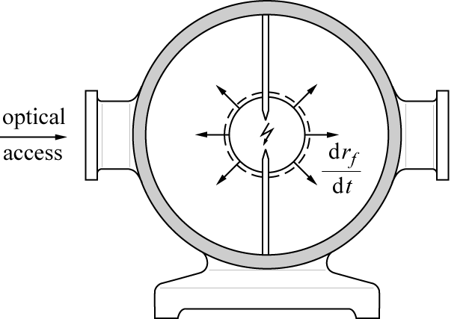
Another example for an
experimental device to measure
laminar burning velocities
is the combustion bomb
within which a flame
is initiated by a central spark.
Spherical propagation of a flame then takes place
which may optically be detected through
quartz windows and the flame propagation velocity dr_{f} /dt may be recorded.
Now the flame front is not stationary.
4.-8

Slide 9
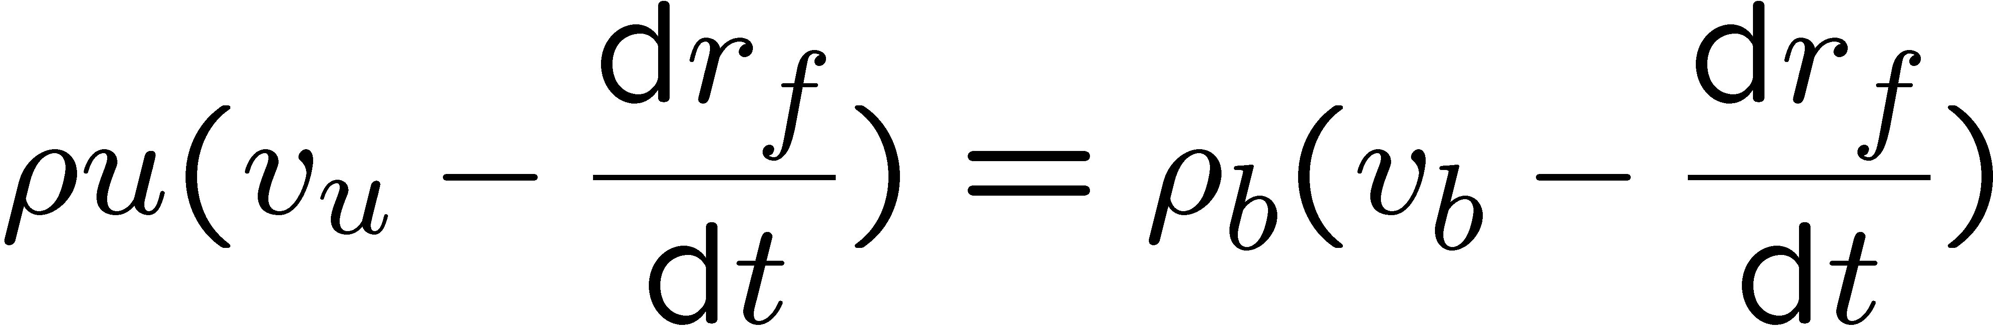
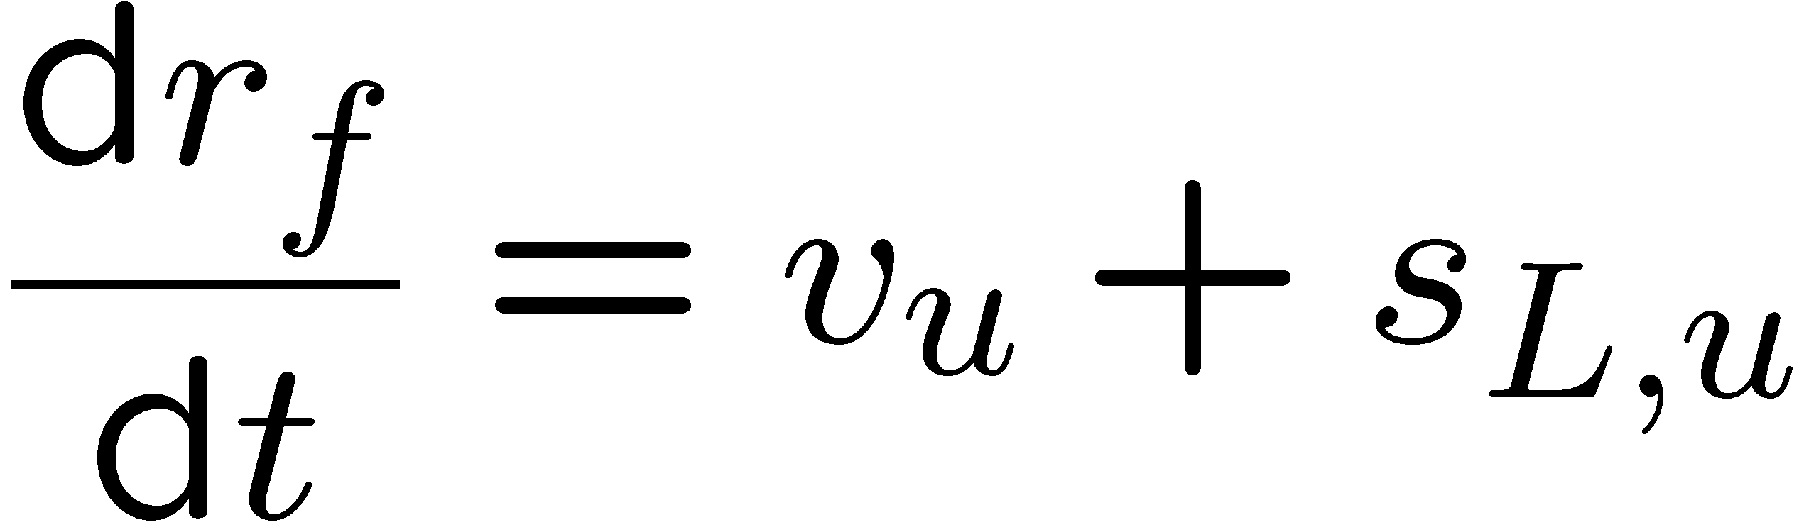
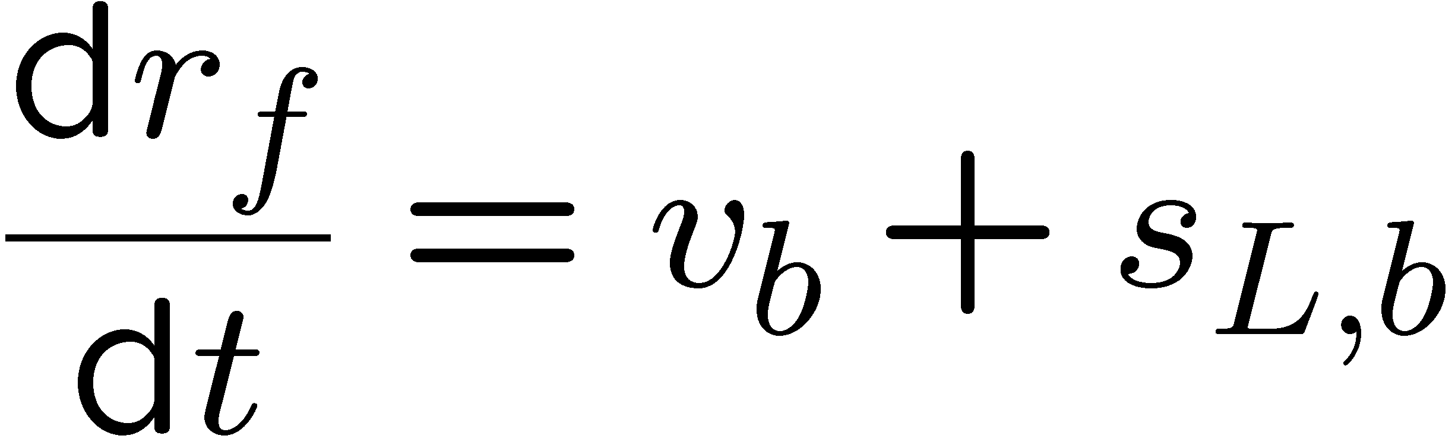
If the radial flow velocities are defined
positive in inward direction, the velocity
of the front must be subtracted from these
in the mass flow balance through the
flame front.
At the flame front the kinematic balance between propagation velocity, flow velocity and burning velocity with respect to the unburnt mixture is
Similarly, the kinematic balance with respect to the burnt gas is
4.-9

Slide 10
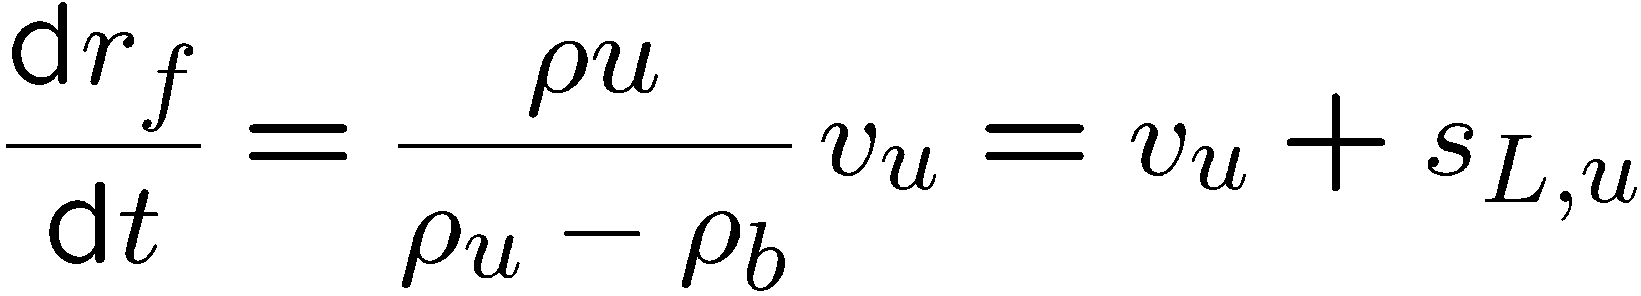
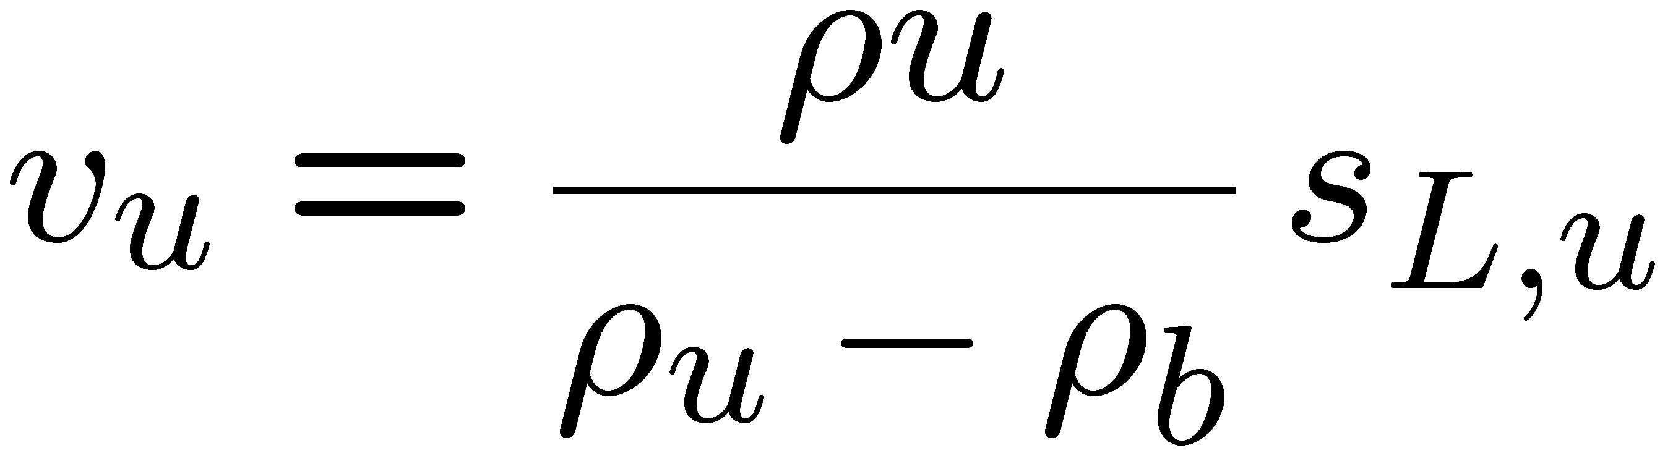
In the present example the flow velocity
in the burnt gas behind the flame is zero
due to symmetry.
This leads to
from which the velocity in the unburnt mixture is calculated as
This velocity is induced by the expansion of the gas behind the flame front.
4.-10

Slide 11
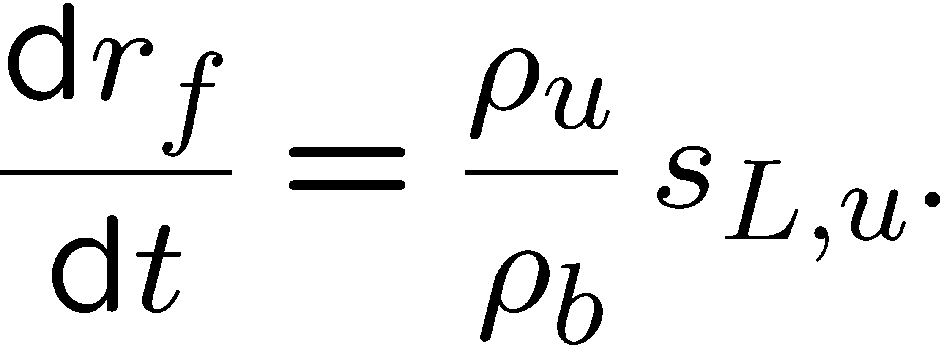
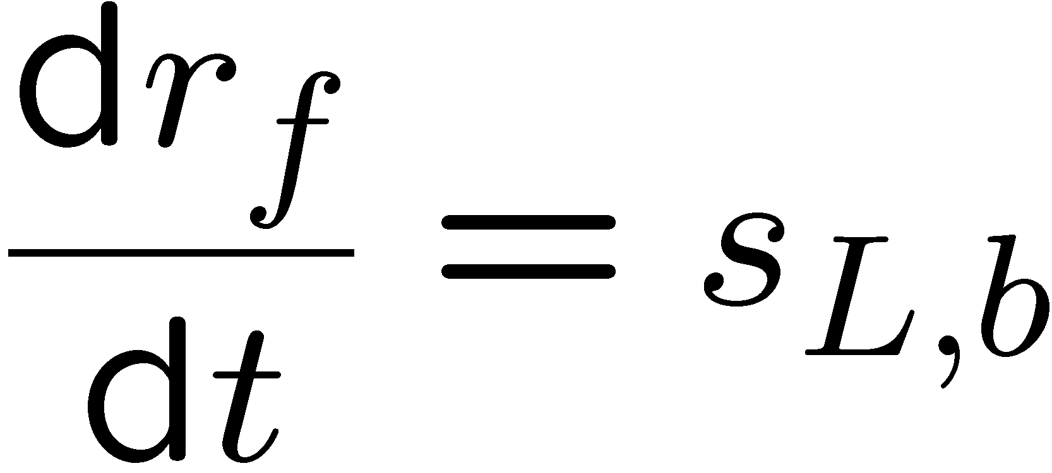
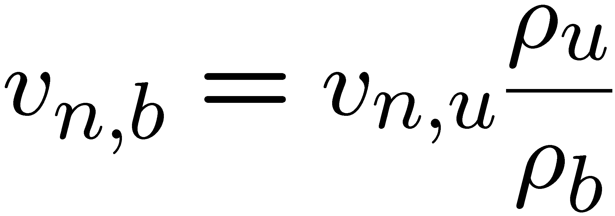
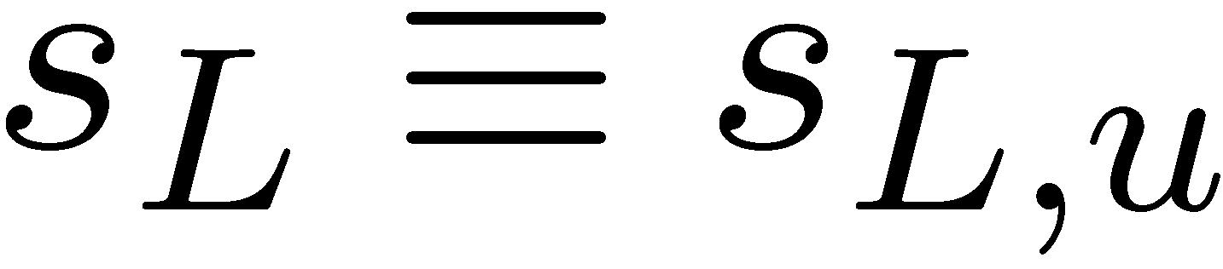
Furthermore it follows that the flame propagation velocity dr_{f}/dt is related to the
burning velocity s_{L,u} by
Measuring the flame propagation velocity then allows to determine s_{L,u}.
Furthermore, from it follows with v_{b} = 0:
The comparison shows that the burning velocity with respect to the burnt gas is by a factor ρ_{u}/ρ_{b} larger than that with respect to the unburnt gas.
This is equivalent to the Bunsen burner case with:
Convenience:
We keep the notation s_{L,b} for the burning velocity with respect to the burnt gas.
4.-11

Slide 12
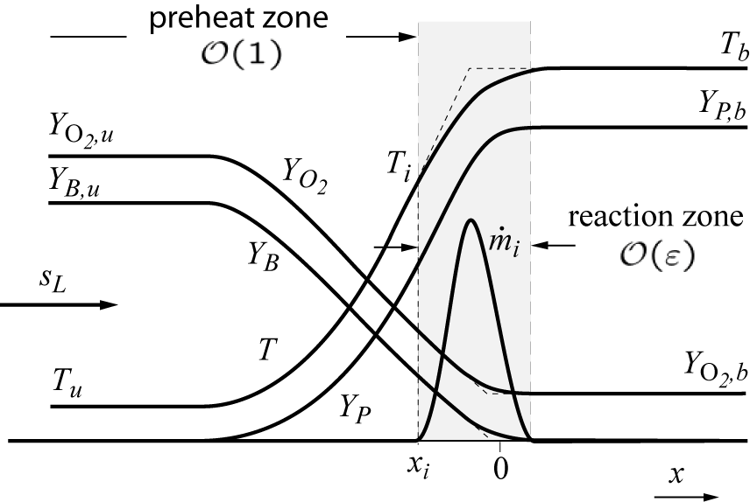
Steady laminar Premixed Flames
Planar steady state flame configuration normal to the x-direction
unburnt mixture at x→ -∞
burnt gas at x→ +∞
4.-12

Slide 13
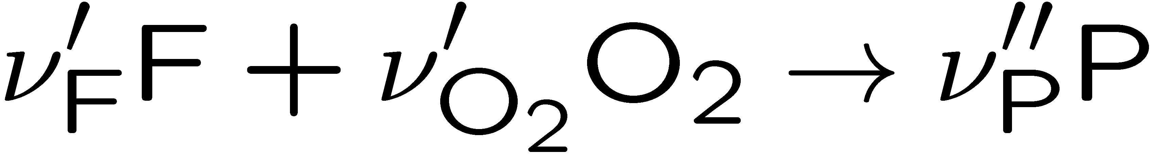
The flame structure for the case of a lean flame with a one-step reaction
The fuel and oxidizer are
convected from upstream
with the burning velocity s_{L}
Having the mass fractions
Y_{F,u} and Y_{O2,u} at x→ -∞
and diffuse into the reaction zone.
The fuel is entirely depleted while the remaining oxygen is convected downstream where it has the mass fraction Y_{O2,u}.
4.-13

Slide 14
The chemical reaction forms the product P and releases heat which leads to a temperature rise.
The mass fraction Y_{P} increases
therefore in a similar
way from zero to Y_{P,b} as the
temperature from T_{u} to T_{b}.
The products diffuses upstream,
and mix with the fuel and the
oxidizer.
Heat conduction from the reaction zone is also directed upstream leading to a preheating of the fuel/air mixture. Therefore the region upstream of the reaction zone is called the preheat zone.
4.-14

Slide 15
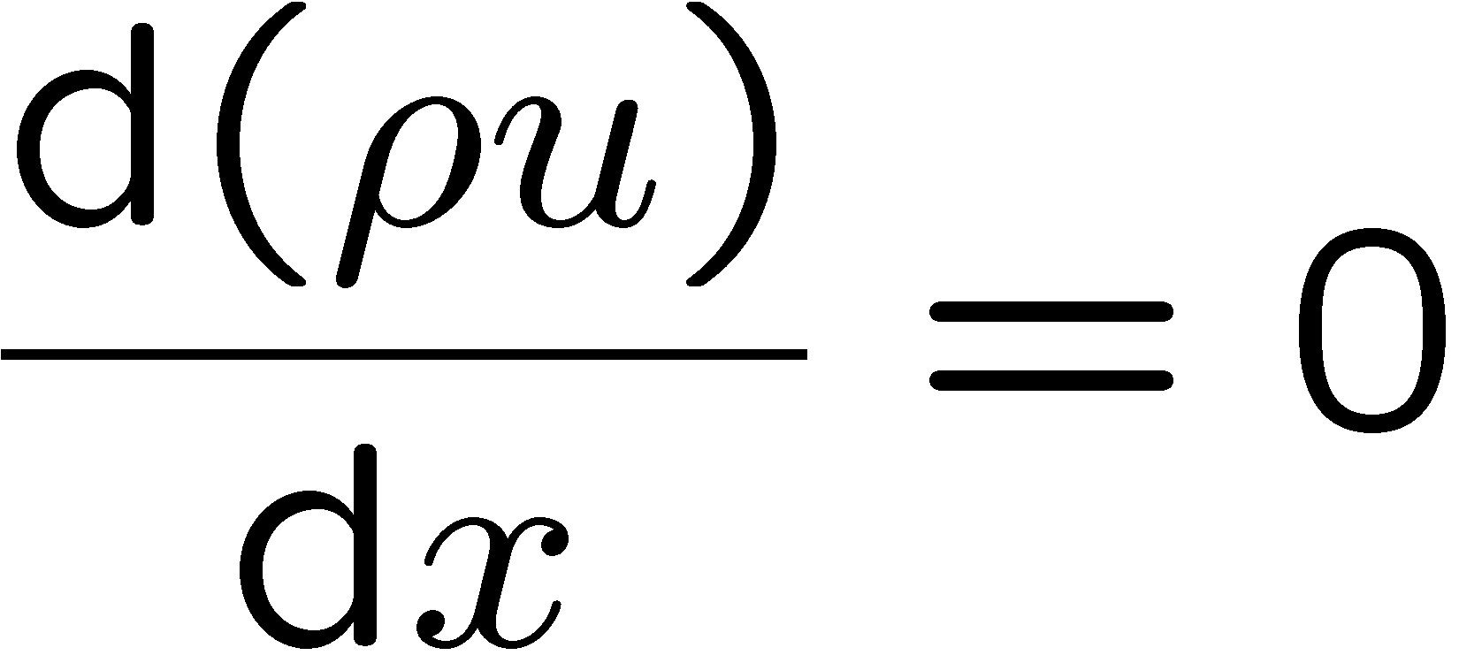
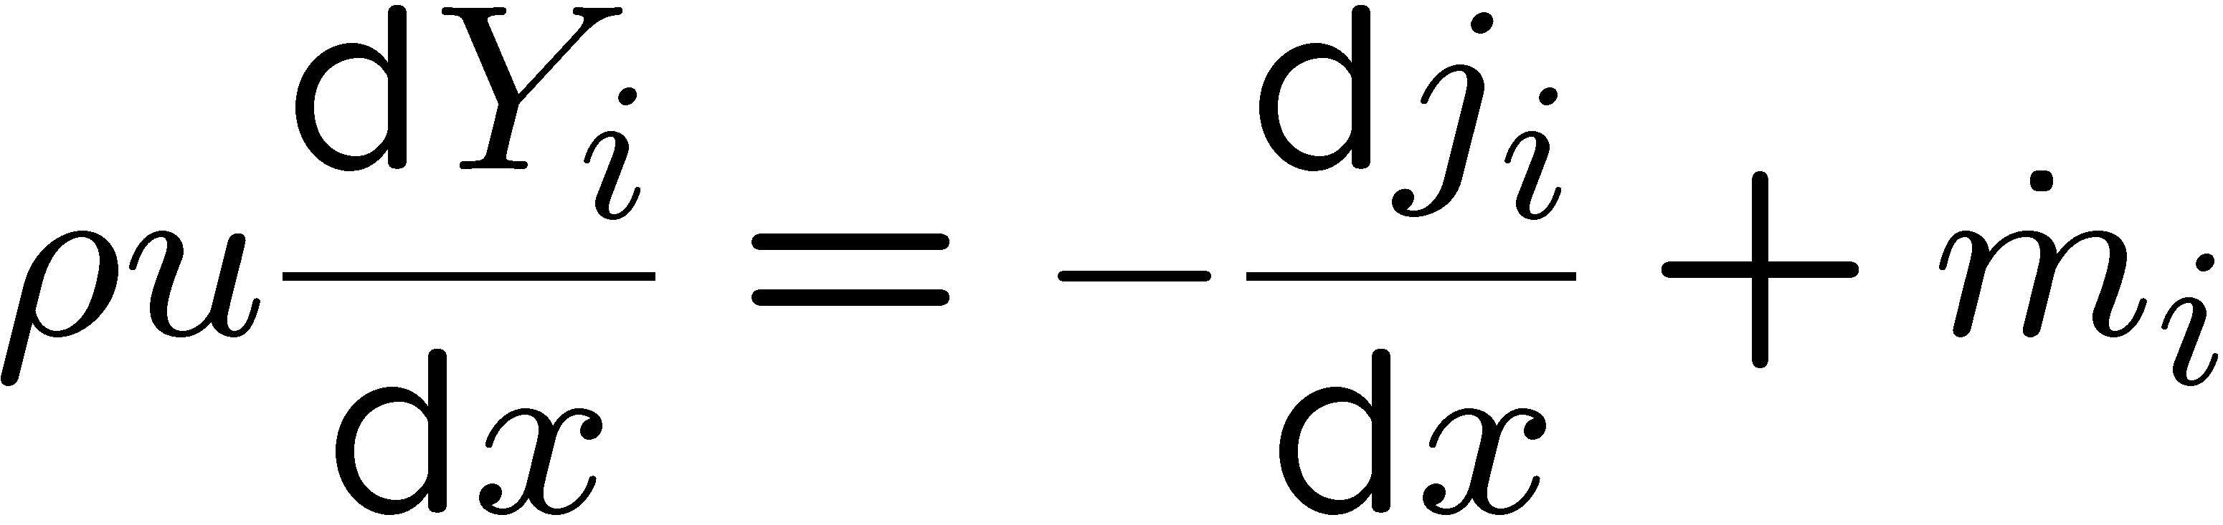
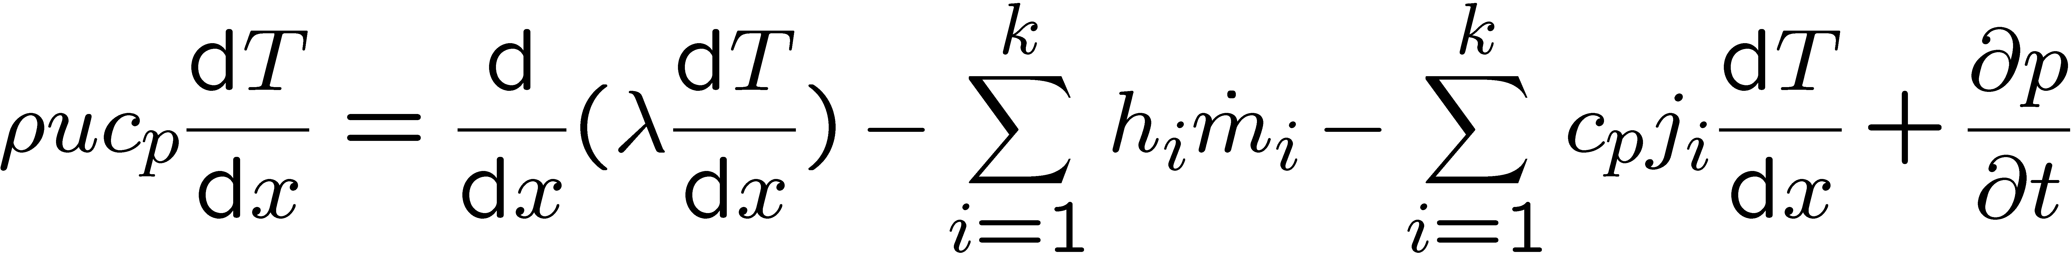
The general case with multi-step chemical kinetics
The fundamental property of a premixed flame, the burning velocity s_{L} may be calculated by solving the governing conservation equations for the overall mass, species and temperature.
Continuity
Species
Energy
4.-15

Slide 16
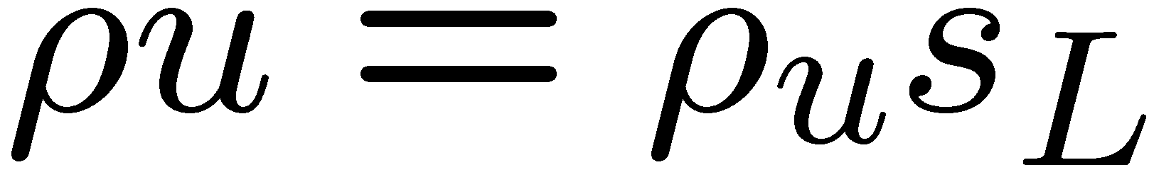
For flame propagation with burning velocities much smaller than the velocity of sound, the pressure is spatially constant and is determined from the thermal equation of state.
Therefore spatial pressure gradients are neglected
The continuity equation may be integrated once to yield
The burning velocity is an eigenvalue, which must be determined as part of the solution.
The system of equations may be solved numerically with the appropriate
upstream boundary conditions for the mass fractions and the temperature and zero
gradient boundary conditions downstream.
4.-16

Slide 17
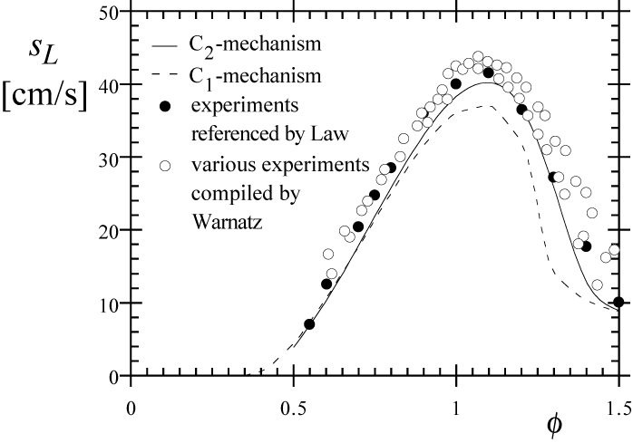
Example: Calculations of the burning velocity of premixed methane-air flames using a mechanism that contains only C₁-hydrocarbons and a mechanism that includes the C₂-species as a function of the equivalence ratio φ [Mauss 1993] .
The two curves are compared
with compilations of various
data from the literature.
It is seen that the calculations
with the C₂-mechanism
shows a better agreement than
the C₁-mechanism.
4.-17

